Slide 1
Predicting Loan Defaults
By: Peyjmon Ahmad

Slide 2

What’s the big deal?
Crucial to profits for banks, customers
Loan defaults, delays are reoccurring problems
Must avoid classification errors
Notes:
Loans drive profitability and success for banks, other institutions. Loans are very important for customers as well, as it is a way to get what you desire even if you don’t have the funds at the moment. But loan defaults can me a major issue for both parties that nobody wants to be a a part of. The bank will have to spend a lot of time hunting down the customer, possibly filing a lawsuit. While a customer’s credit score can decrease drastically, and they might not even be able to apply for a loan in the future. From the bank’s perspective, it is crucial to avoid classification errors, specifically false positives. In this situation, the bank will expect a customer to honor their loan, but in reality they default. A false negative is negatively impactful as well, but not as much as a false positive.

Slide 3






Tools Data

Slide 4
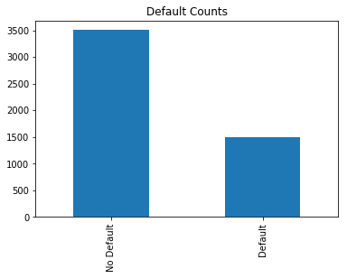
Default vs. Non-Default
Main Features
Numeric: checking balance, duration, savings balance, years at employment, num of credits, age, dependents
Categorical: purpose, credit history, sex, skilled worker, marital status, housing

Slide 5
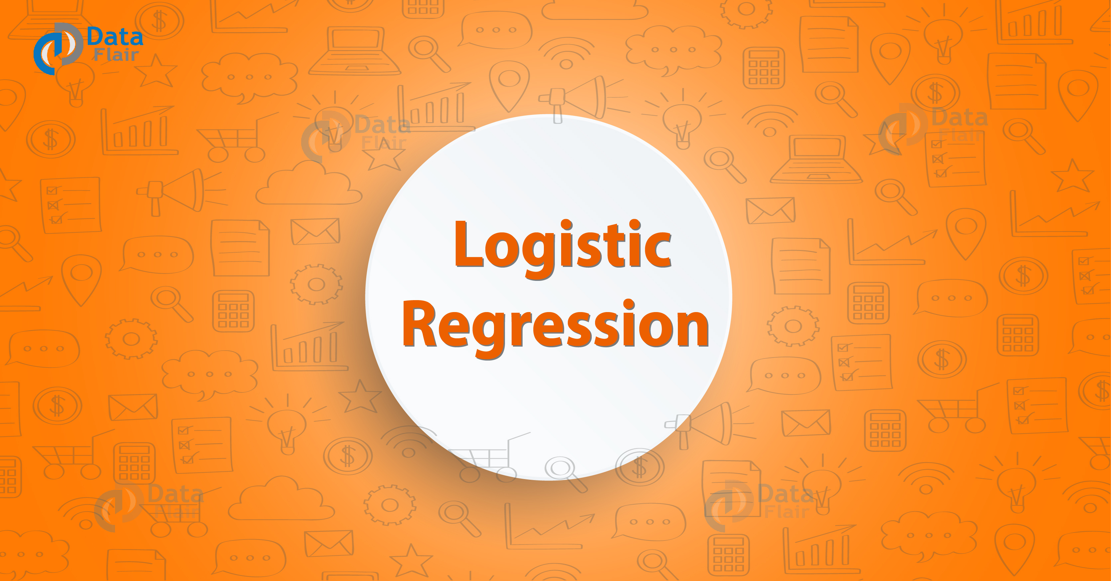

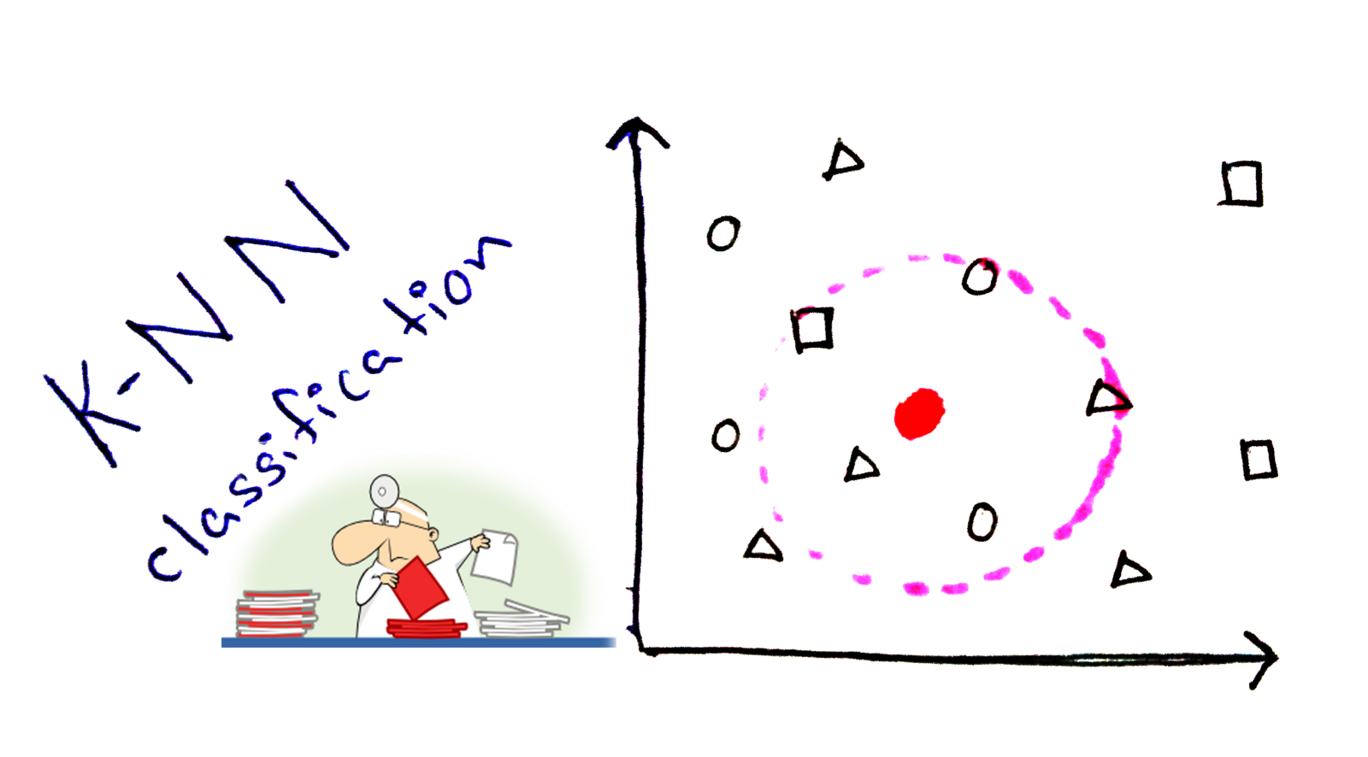
Models

Slide 6
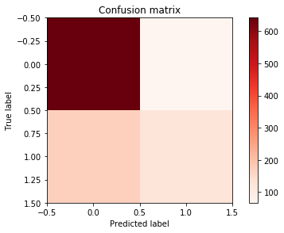
Logistic Regression
Used Grid Search CV
About 73% accuracy
False Positive
Notes:
Grid Search CV found the optimal C, which is the inverse of regularization strength. Smaller value of C indicates a stronger regularization

Slide 7
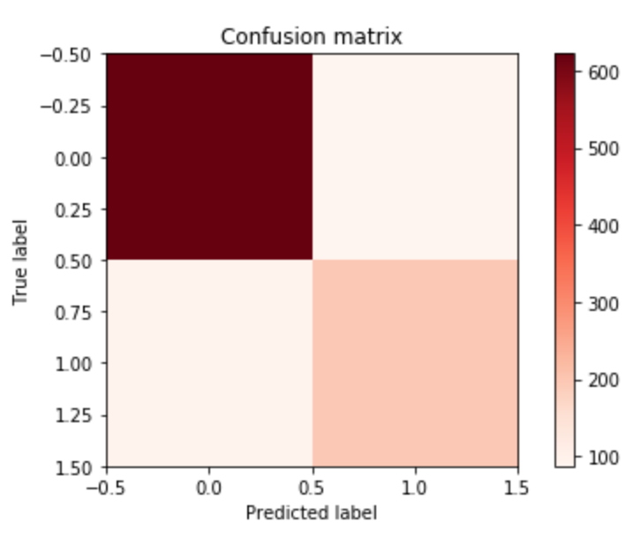
KNN (Nearest Neighbors)
Minimizes false positives
Precision: 86%
False Positive (Lighter)

Slide 8
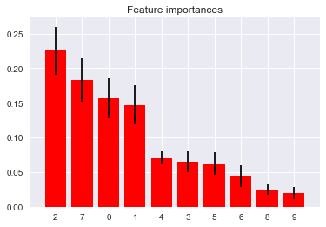
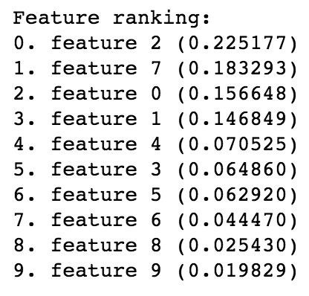
Random Forest
Precision: 87%
Duration (Months)
Age
Credit Amount
Years at Present Employment
Savings Account Balance
Notes:
I would suggest that maybe the bank can have a certain threshold for these features. If someone is above a threshold, they can have stricter rules for their policy of accepting loans

Slide 9
How much do they increase risk?
Duration: 1.3% increase for every month
Credit Amount: 1.5% increase for every $1000
Years at Present Employment: 2.1% decrease for every year
Age: 1.2% decrease for every year
Savings Account: 1.1% decrease every $500

Slide 10
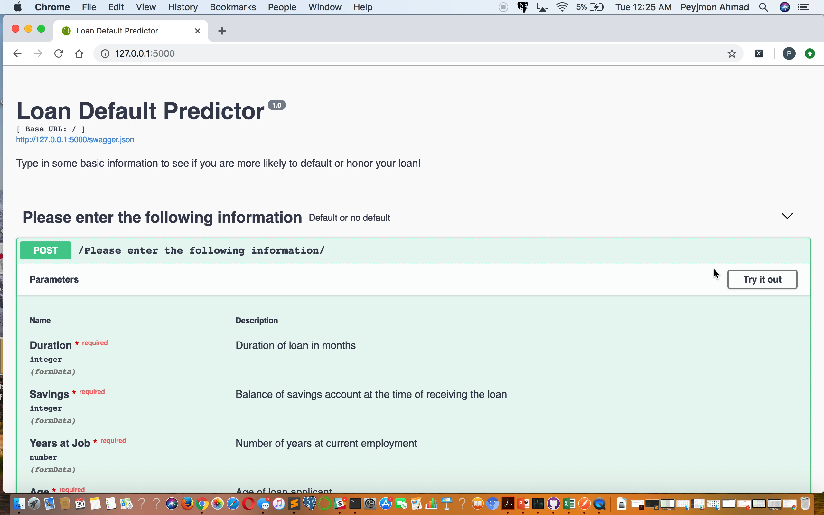

Slide 11

Thanks for listening!
Don’t end up like this…

